Slide 1

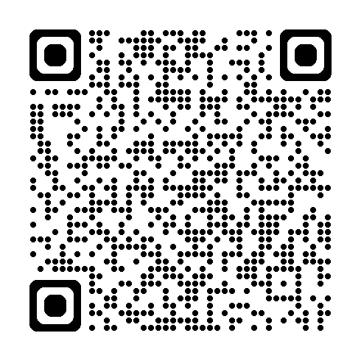
Handheld Hydrophone Kit
────────────────────────
🏷️ PROPERTY OF:
Chohla Moll
Mt. Edgecumbe High School, Sitka, AK
✉️ Email: chohlam@mehs.us
────────────────────────
📘 User Manual:
Scan the QR Code

